Slide 1

Aitkin County Sobriety Court Presentation
July 9, 2013
2006-Current

Slide 2
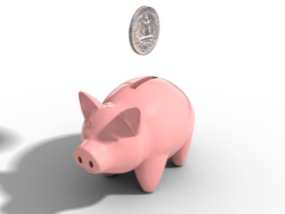
Funding Sources
County initially funded part time coordinator
State funding began paying for full time agent and part time coordinator in late 2007
Funding from state reduced in 12/09 and coordinator was eliminated
Funding from the state in combination with county funds has varied since 2010.
Currently grant approved at the state level funds approximately 50% of agent costs from 7/1/13 to 6/30/15.

Slide 3
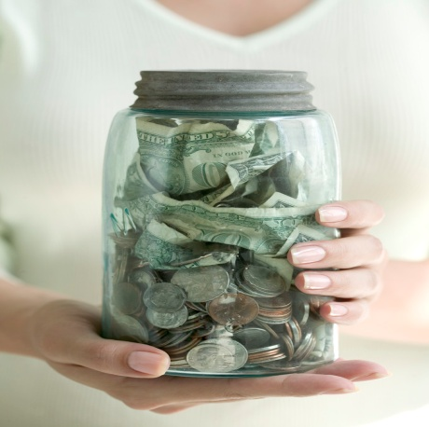
COST SAVINGS
A recent cost-related meta-analysis concluded
that Drug Courts produce an average of $2.21 in direct
benefits to the criminal justice system for every $1.00
invested — a 221% return on investment (Bhati et al.,
2008). When Drug Courts targeted their services to the
more serious, higher-risk offenders, the average return on
investment was determined to be even higher: $3.36 for
every $1.00 invested

Slide 4
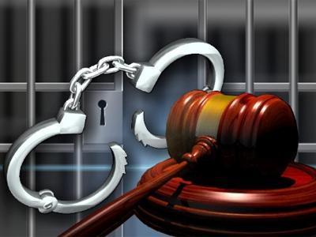
SOBRIETY COURT OFFERS
Alternative to Jail
Increased opportunities to change through full time employment
Reduced need for assistance
Stable living environments are encouraged
Obtain a driver license
Reduced recidivism rates

Slide 5

Taxpayer Savings
Sobriety Court has served six families who were involved with child protection services. These particular families had children in placement who were able to return home after parents were stabilized in the program.
77 total dependent children have had parents in sobriety court.

Slide 6
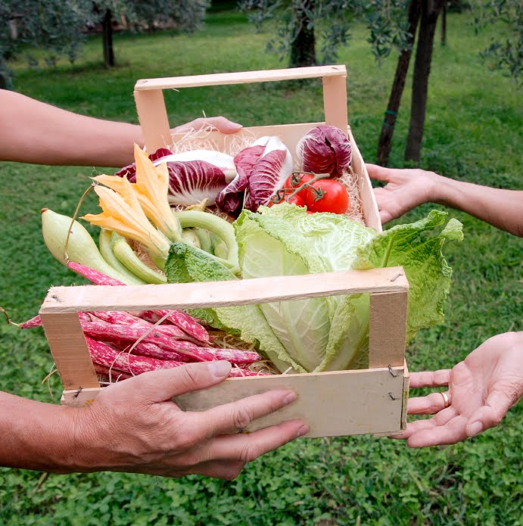
Taxpayer Savings
Approximately 50% of graduates were no longer reliant on food support after graduating from the program.
To put this into perspective- just 2 families of 4 no longer needing support have an estimated taxpayer savings of $35,928 for an 18 month period.

Slide 7
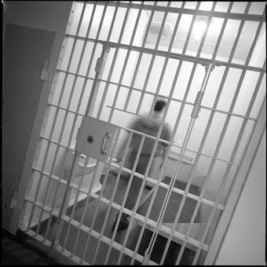
Jail Cost Savings
At the end of 2010, graduates from Aitkin Sobriety Court had served 52 days in jail during the program or after completing the program costing approximately $2600
A control group (those who never had an opportunity at completing sobriety court) served 980 days in jail with an approximate cost of $49,000

Slide 8
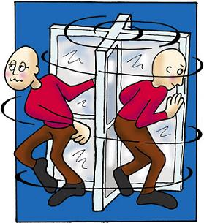
Recidivism Rates
Graduate recidivism rates (committing a new offense) were at a rate of 5% compared to the control group rate of 67%, or non-completer at 28%. Only one graduate has committed a new alcohol offense! There have
been no drug related offenses
of those who graduated.

Slide 9
